Slide 1

CHAT WITH CUBAP
- Sameeri Mamillapalli
181801120004

Slide 2


Chatbots So far…
Decision-Tree Logic.
Canned-Responses
Restricted to anticipated user engagements
Bots can continue to help us with automated repetitive , low-level tasks and queries

Slide 3
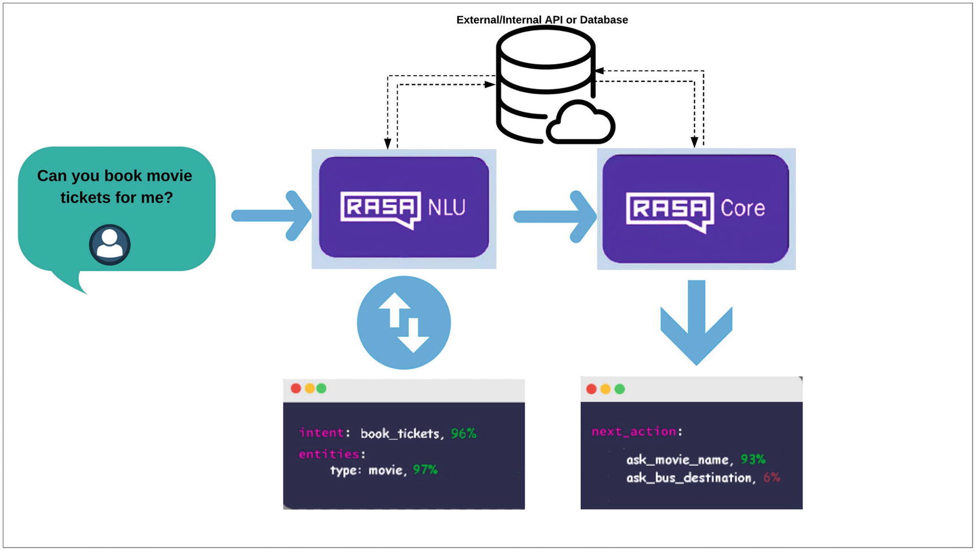
RASA FRAMEWORK
RASA
It is a Framework bootstrapping conversational chatbot
Components:-
RASA NLU
RASA CORE
Intents
Entities
Slots
Actions
Policies
Template

Slide 4
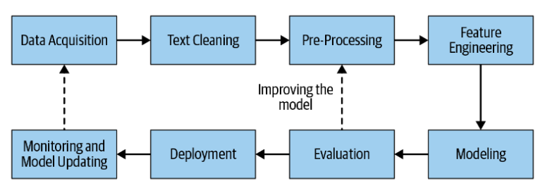
RASA NLU
RASA Natural Language Understanding
NLU is used for intent classification and entity extraction in chatbots
Pipelines Preconfigured:
Spacy-sklearn
TensorFlow-Embedding
Feature Engineering Inbuilt Methods:-
Count-Vectorizer
TF-IDF

Slide 5
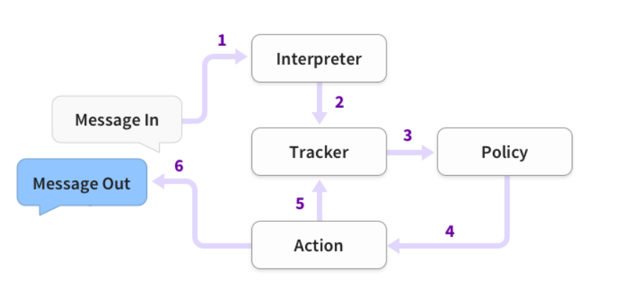
RASA CORE
RASA CORE
Rasa core Job is to decide what should happen during the course of dialogue
Stories
Domain.yml
Dialogue model
RASA POLICIES
Policies Predicts Intents based on Intents
Keras Policy
Fallback Policy
Custom Policy

Slide 6

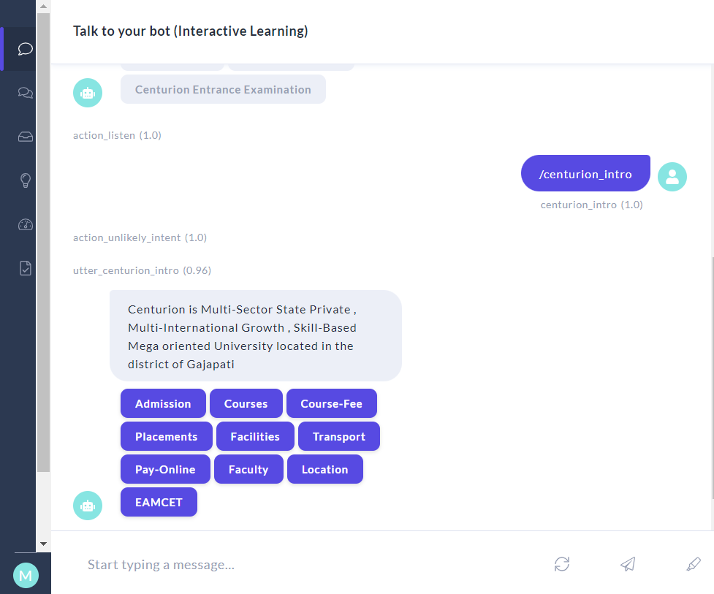
RASA CUBAP
Domain.yml
Stories.yml
NLU.yml

Slide 7
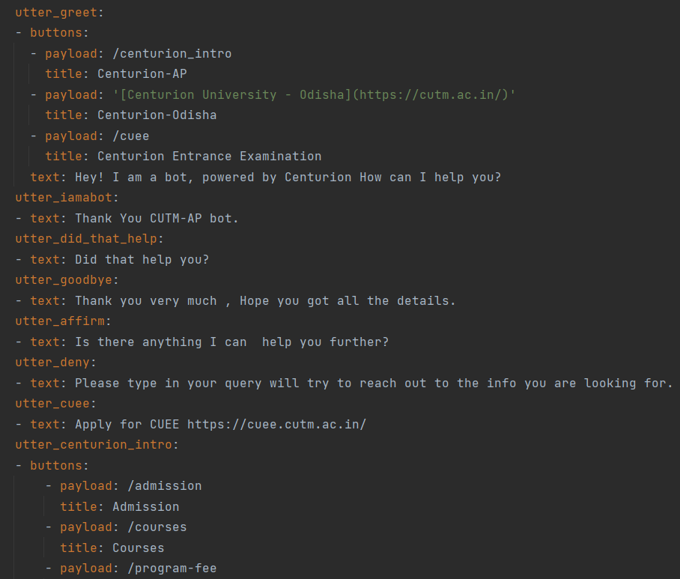
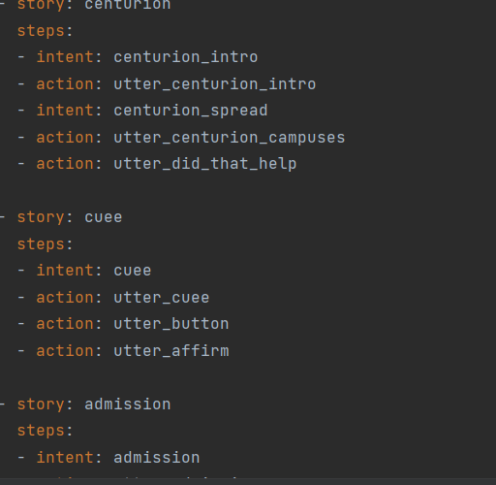
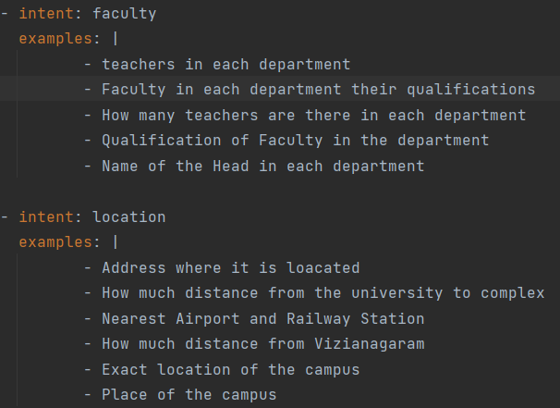
Domain
Stories
NLU

Slide 8
INTENTS CHOOSEN
- utter_greet
- utter_iamabot
- utter_did_that_help
- utter_happy
- utter_cheer_up
- utter_centurion_intro
- utter_cuee
- utter_centurion_campuses
- utter_admission
- utter_courses
- utter_placements
- utter_facilities
- utter_transport
- utter_payment
- utter_location
- utter_faculty
- utter_program-fee
- utter_eamcet
- utter_affirm
- utter_button
- utter_goodbye

Slide 9
Training Model
LSTM
Long Short-Term Memory networks – usually just called “LSTMs” – are a special kind of RNN, capable of learning long-term dependencies. They were introduced by Hochreiter & Schmidhuber (1997), and were refined and popularized by many people in following work. They work tremendously well on a large variety of problems, and are now widely used.
LSTMs are explicitly designed to avoid the long-term dependency problem.
Remembering information for long periods of time is practically their default behavior, not something they struggle to learn!
All recurrent neural networks have the form of a chain of repeating modules of neural network.
In standard RNNs, this repeating module will have a very simple structure, such as a single tanh layer.
LSTMs also have this chain like structure, but the repeating module has a different structure.

Slide 10
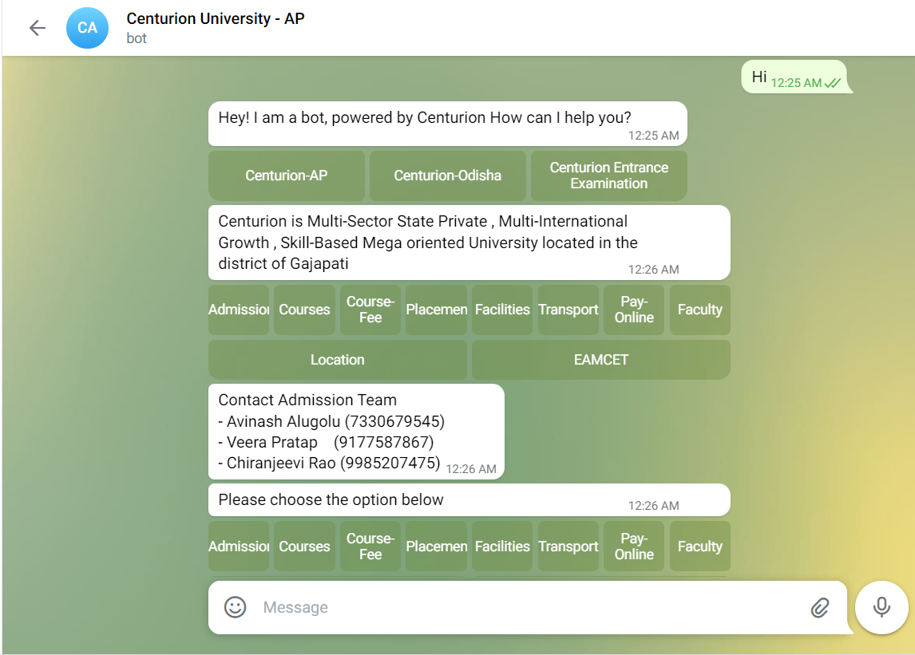
Telegram Integration
Screenshots of Proposed System

Slide 11
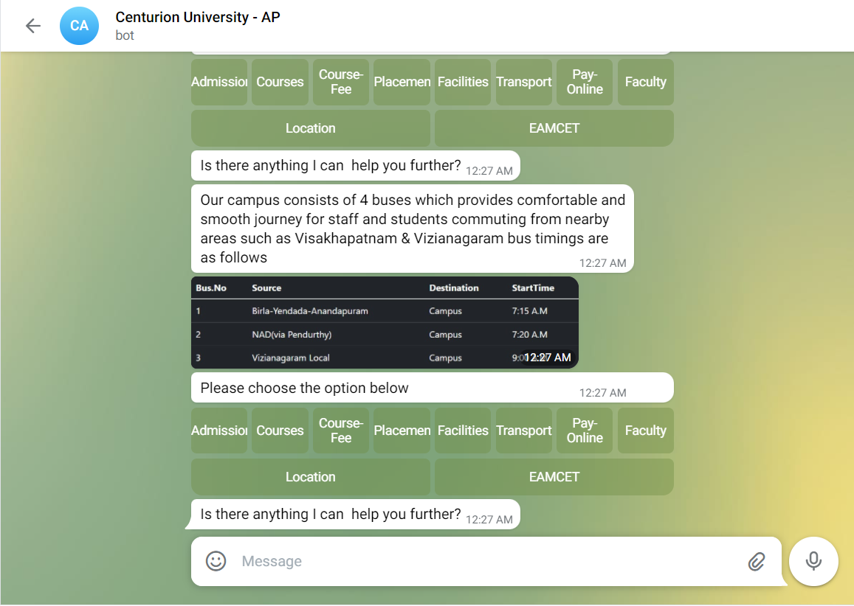
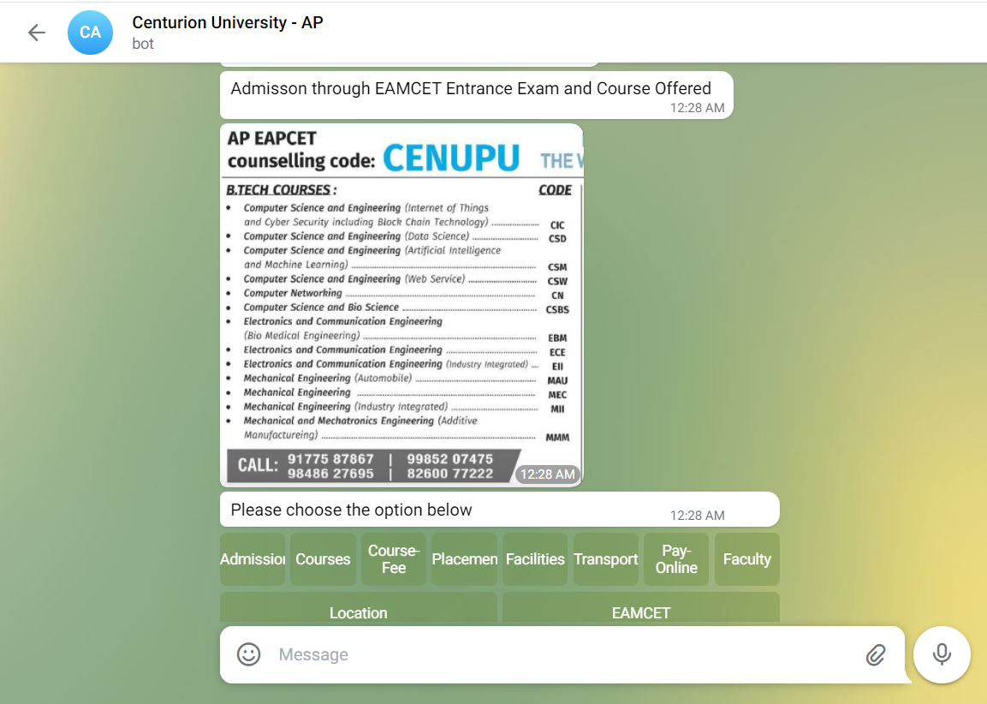

Slide 12
CONCLUSION
Rasa is fully customizable and easily interchangeable. It is possible, and sometimes recommended to use Rasa Core or Rasa NLU separately. When using Rasa NLU, we can choose among several backend NLP (Natural Language Processing) libraries. The LSTM neural network which Rasa Core uses for action prediction can be easily exchanged for any other type of Neural Network, if you know how to implement them in Keras. The other competent frameworks have a lot of data sharing issues, as in we need to share data with them. It is an open-source bot building framework. It doesn’t have any pre-built, pre-existing and downloadable models on a server that we can call using an API. This gives complete control of all the components in the chatbot. Finally, CUBAP is completely based on intent as well as NLU classification with LSTM as its backend based on the training and testing it can work both text as well payload based but more number of intents are to be added so as to reduce the ambiguity of the model and better performance over new text. Since pipeline is very similar where all the preprocessing happens it is up to the NLU trained by the user . Telegram integration is successful but UI on mobile is not suggested due to react issues and can be solved in further bugs.

